Slide 1
Activity #5 Automatic Eco Light
LED does not glow when the surrounding has fair amount of light.
LED glows when it gets dark
The glow intensity increases as it gets darker

Slide 2
Keep the circuit you build for next activity!

Slide 3
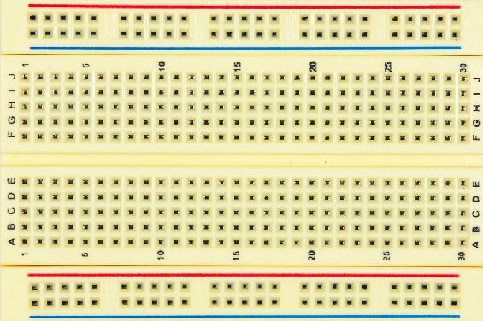
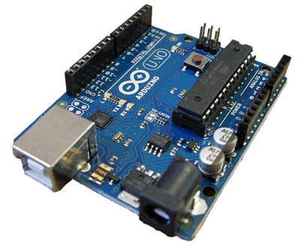
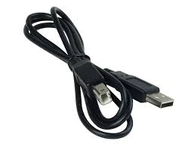
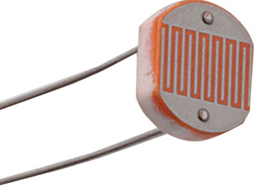
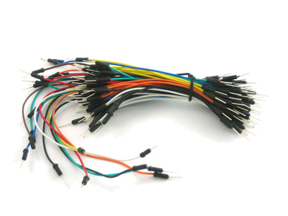
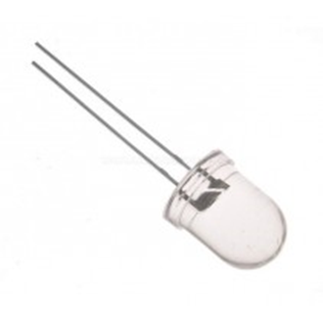
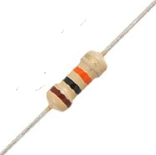
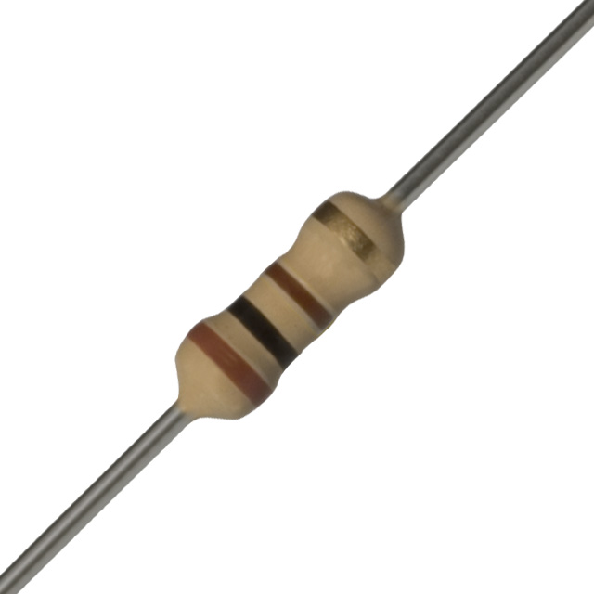

What do you need?
USB cable
Arduino
Breadboard
Light
Dependent
resistor (LDR)
Brown Ring
Black Ring
Brown Ring
Orange Ring
Black Ring
Brown Ring
White LED
Resistor (10 Kilo ohms)
Resistor (100 ohms)
Laptop

Slide 4
I am Light Dependent Resistor ….
You can call me LDR
When there is light, my resistance is low
More current flows thru me
When it is dark my resistance is high
Less current flows thru me

Slide 5
Circuit Diagram
100 Ω
9 5V
A0
Arduino
W
10K Ω
GND

Slide 6
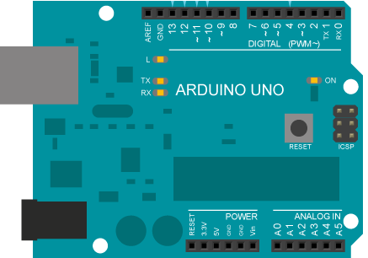
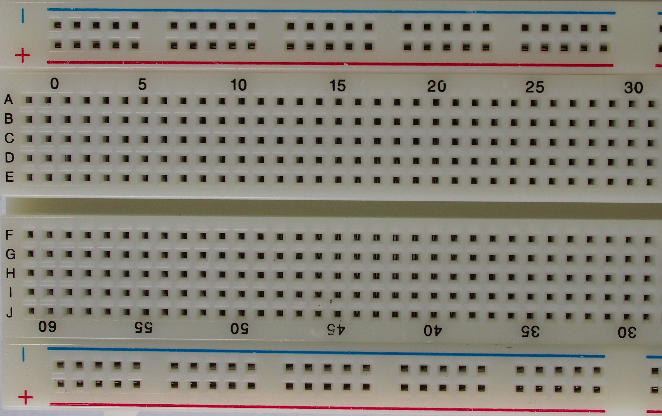
100 Ω
LED
10K Ω
LDR

Slide 7
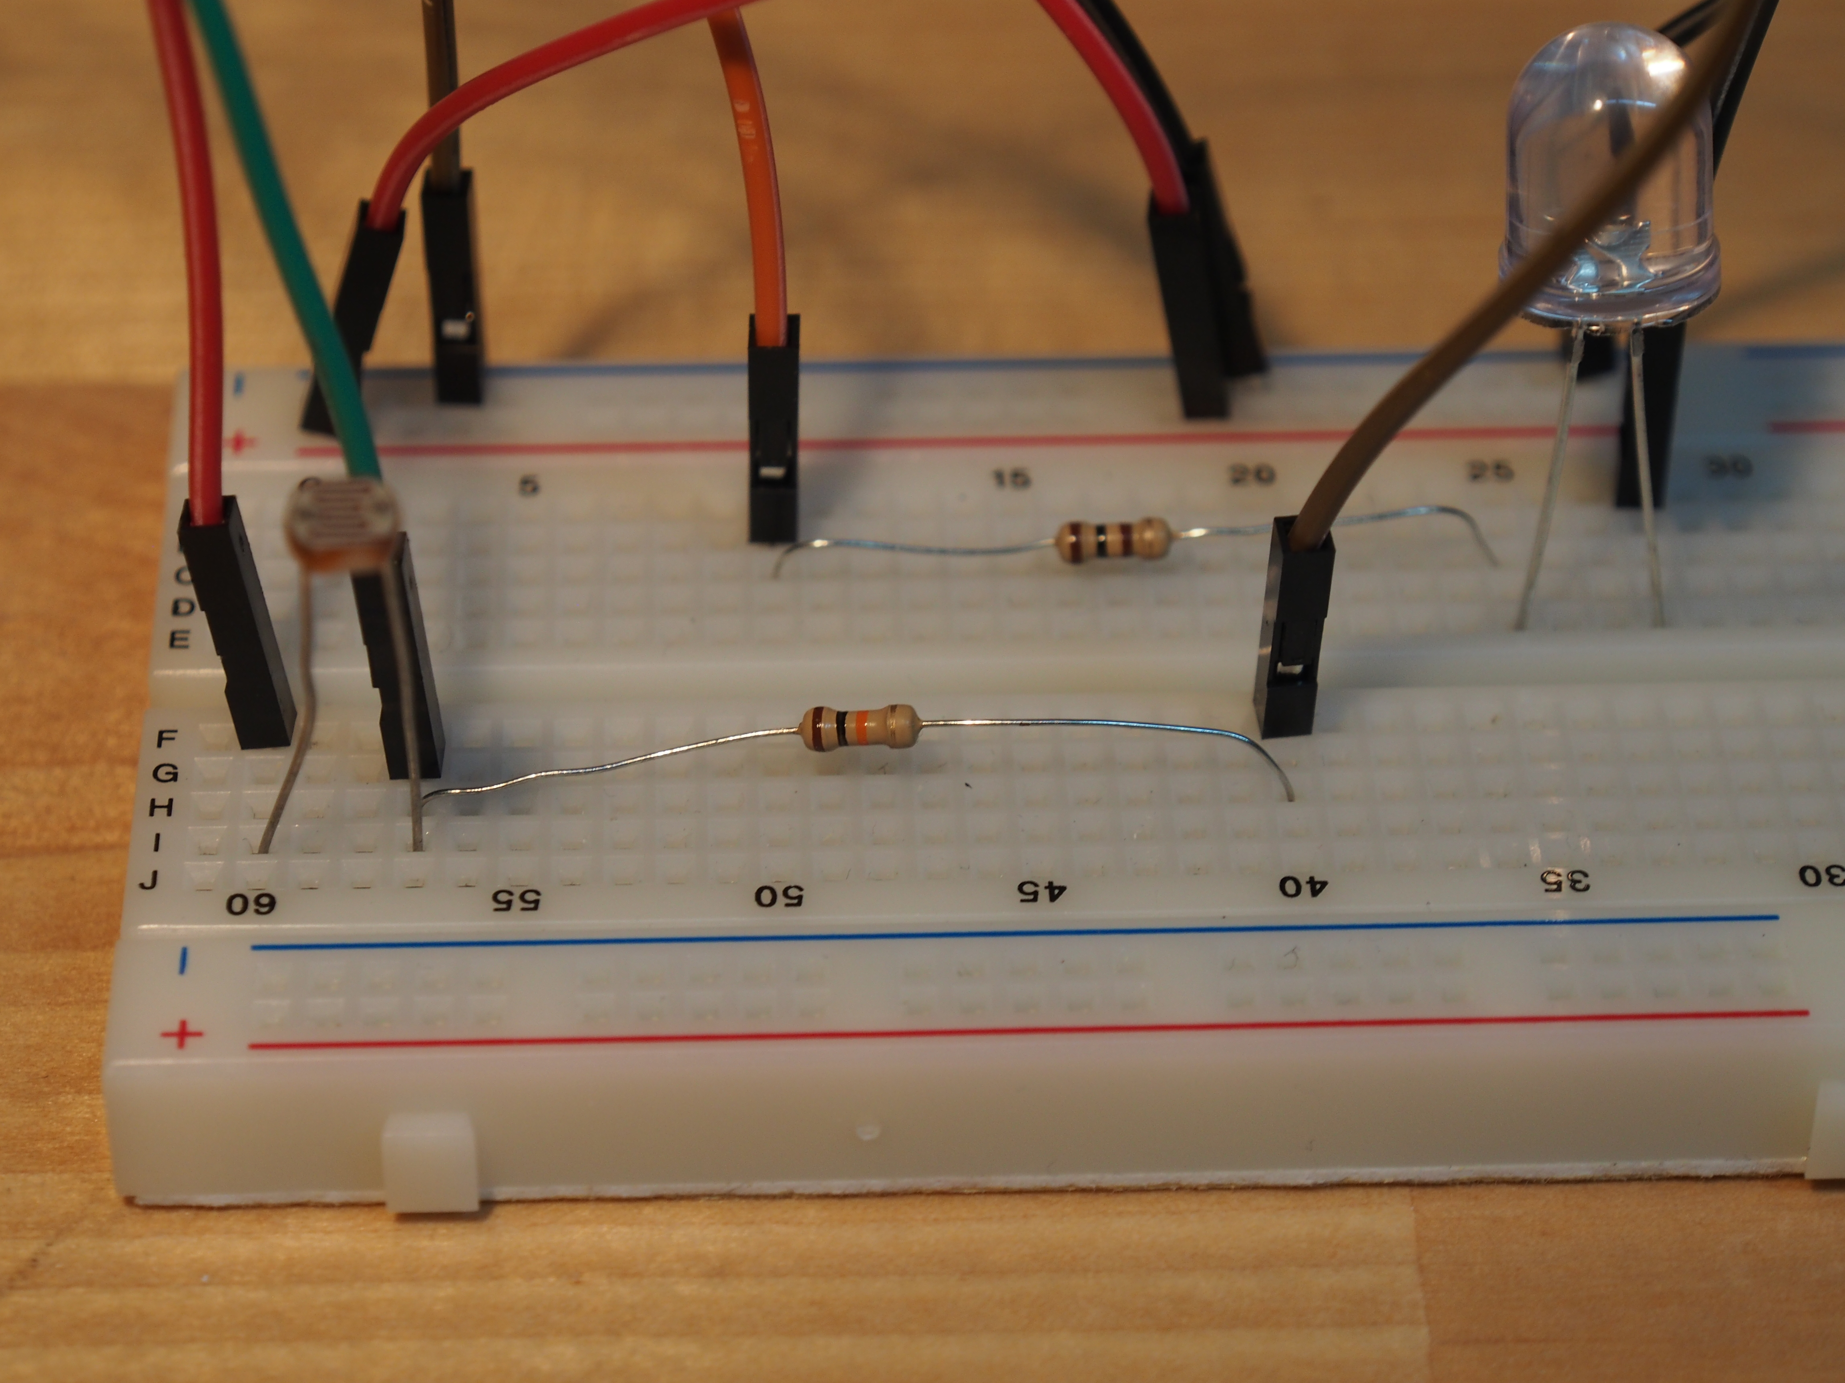
Connect –ve (Black Wire) to GND of Arduino
Connect +ve (Red Wire) to 5V of Arduino
Connect orange wire to Port 9 of Arduino
Connect Green wire to Port A0 of Arduino
To +ve
Connect brown wire to -ve
To -ve
Let’s build!
Long leg

Slide 8
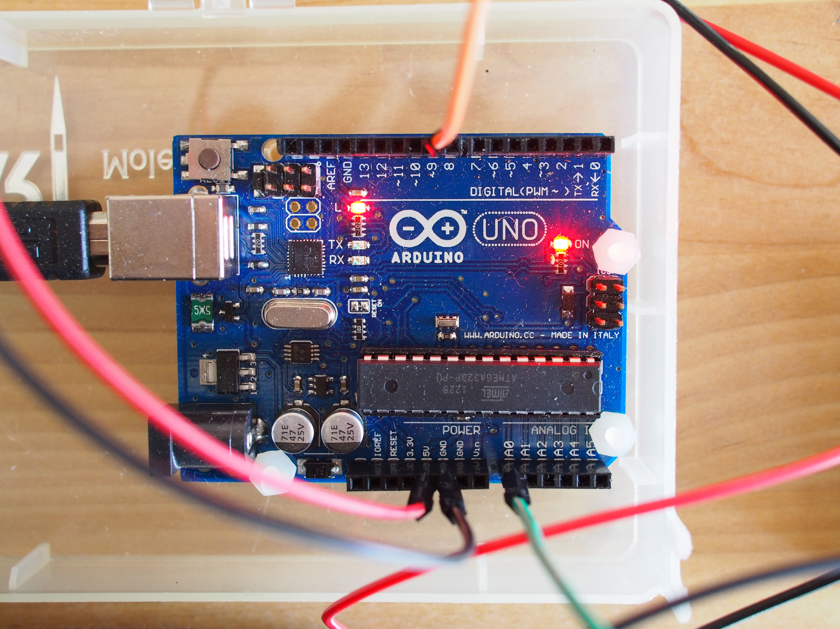
Connect Port 9 to LED’s resistor
Connect 5V to +ve of Board
Connect
GND to
-ve of
Board
Connect USB cable
To computer
Let’s build!
Connect LDR to Port A0

Slide 9
Sketch – Part 1
const int LED_PORT = 9 ;
const int LIGHT_SENSOR_PORT = 0 ;
const int INTERVAL = 1000 ; // we will check brightness 1000 millisecond or 1 second
int sensedValue ; // value sensed on the Analog input port
float voltage ; // a number between 0 and 5 Volts
float light ; // a number between 0 and 1, 0 means very dark, 1 means bright
float darkness ; // a number between 0 and 1, 1 means it is very dark)
float needLight ;
int setLEDTo ; // value to output on the analog port for LED
Notes:
Copy the sketch if you want to …. Copy the folder to Arduino directory.

Slide 10
Sketch – Part 2
void setup() {
pinMode(LED_PORT, OUTPUT);
pinMode(LIGHT_SENSOR_PORT, INPUT);
Serial.begin(9600) ;
for (int i = 0; i<=255 ; i++ ) {
analogWrite (LED_PORT,i);
Serial.println(i);
delay (100);
}
analogWrite (LED_PORT, 0);
delay (100);
}

Slide 11
void loop() {
sensedValue = analogRead(LIGHT_SENSOR_PORT) ;
// read the input on analog port
// Convert the analog reading (which goes from 0-1023) to a voltage (0-5V):
// Voltage will only go from 0.4 to 2.5 approximately only
voltage = sensedValue * 0.0049 ;
light = sensedValue / 1023.0 ;
darkness = 1 - light ;
if ( darkness > 0.5 ) needLight = ( darkness - 0.5 ) / ( 1 - 0.5 );
else needLight = 0 ;
setLEDTo = 255 * needLight ;
analogWrite (LED_PORT,setLEDTo);
Serial.print("Sensor Value = "); Serial.print(sensedValue);
Serial.print(" Voltage ="); Serial.print(voltage);
Serial.print(" Light ="); Serial.print(light);
Serial.print(" Darkness ="); Serial.print(darkness);
Serial.print(" need light ="); Serial.print(needLight);
Serial.print(" Set LED port to ="); Serial.println(setLEDTo);
delay (INTERVAL);
}

Slide 12
Keep the circuit you build for next activity!

Slide 13
Analog Input Port
Signal on the port is measured as a number between 0 and 1023
Example
If voltage on the port is 5 V, value of the input is measured as 1023
If voltage on the port is 2.5 V, value of the input is measured as 612
If voltage on the port is 0 V, value of the input is measured as 0

Slide 14
Analog Output Port
Signal of value between 0 and 255 can be sent out. 0 means 0 Volts. 255 means 5 Volts.
Example
If 255 is written to the output port, signal on the pin goes to 5 Volts.
If 123 is written to the output port, signal on the pin goes to 2.5 Volts.
If 0 is written to the output port, signal on the pin goes to 0 Volts.

Slide 15
How does it work?
100 Ω
Bright
Lot’s of light !
2K Ω
9 5V
A0
Arduino
W
10K Ω
GND
LDR offers resistance of about 2500 ohms
Voltage across 10 Kilo Ω Resistor is about 4 volts
Current flowing 0.4 milli Amps
Arduino senses a value of about 800
on the Analog input port A0
Notes:
Show the sketch

Slide 16
How does it work?
100 Ω
Dark . No light!
500K Ω
9 5V
A0
Arduino
W
10K Ω
GND
LDR offers resistance of about 500,000 ohms
Voltage across 10,000 ohm resistor drops to about 0.01 volts
Current flowing drops to about 0.001 milli Amps
Arduino senses a value of about 2
on the Analog input port A0

Slide 17
Activity #6 Remote controlled light
Re-use the light sensor and LED circuit we built earlier
Instead of Arduino automatically switching on or off the LED, this time we will control it over the network.
We will check the lighting situation around our sensor from another computer
Turn On or Turn Off the LED by sending command from another computer.

Slide 18
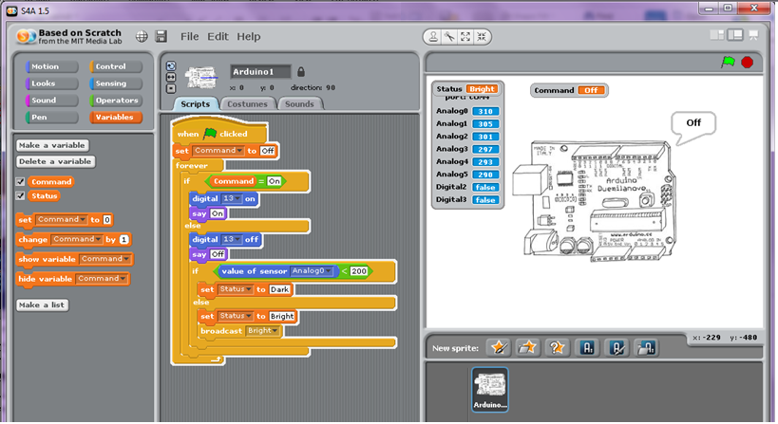
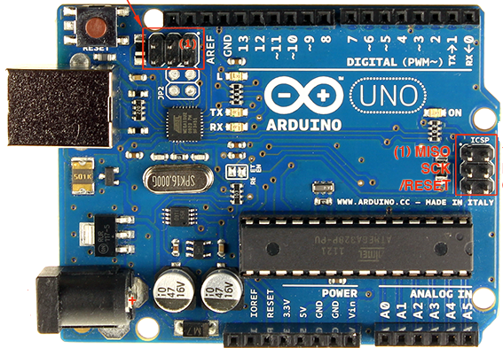
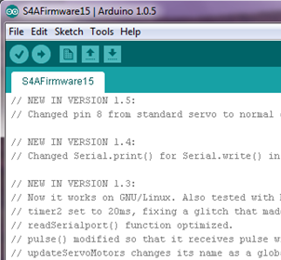
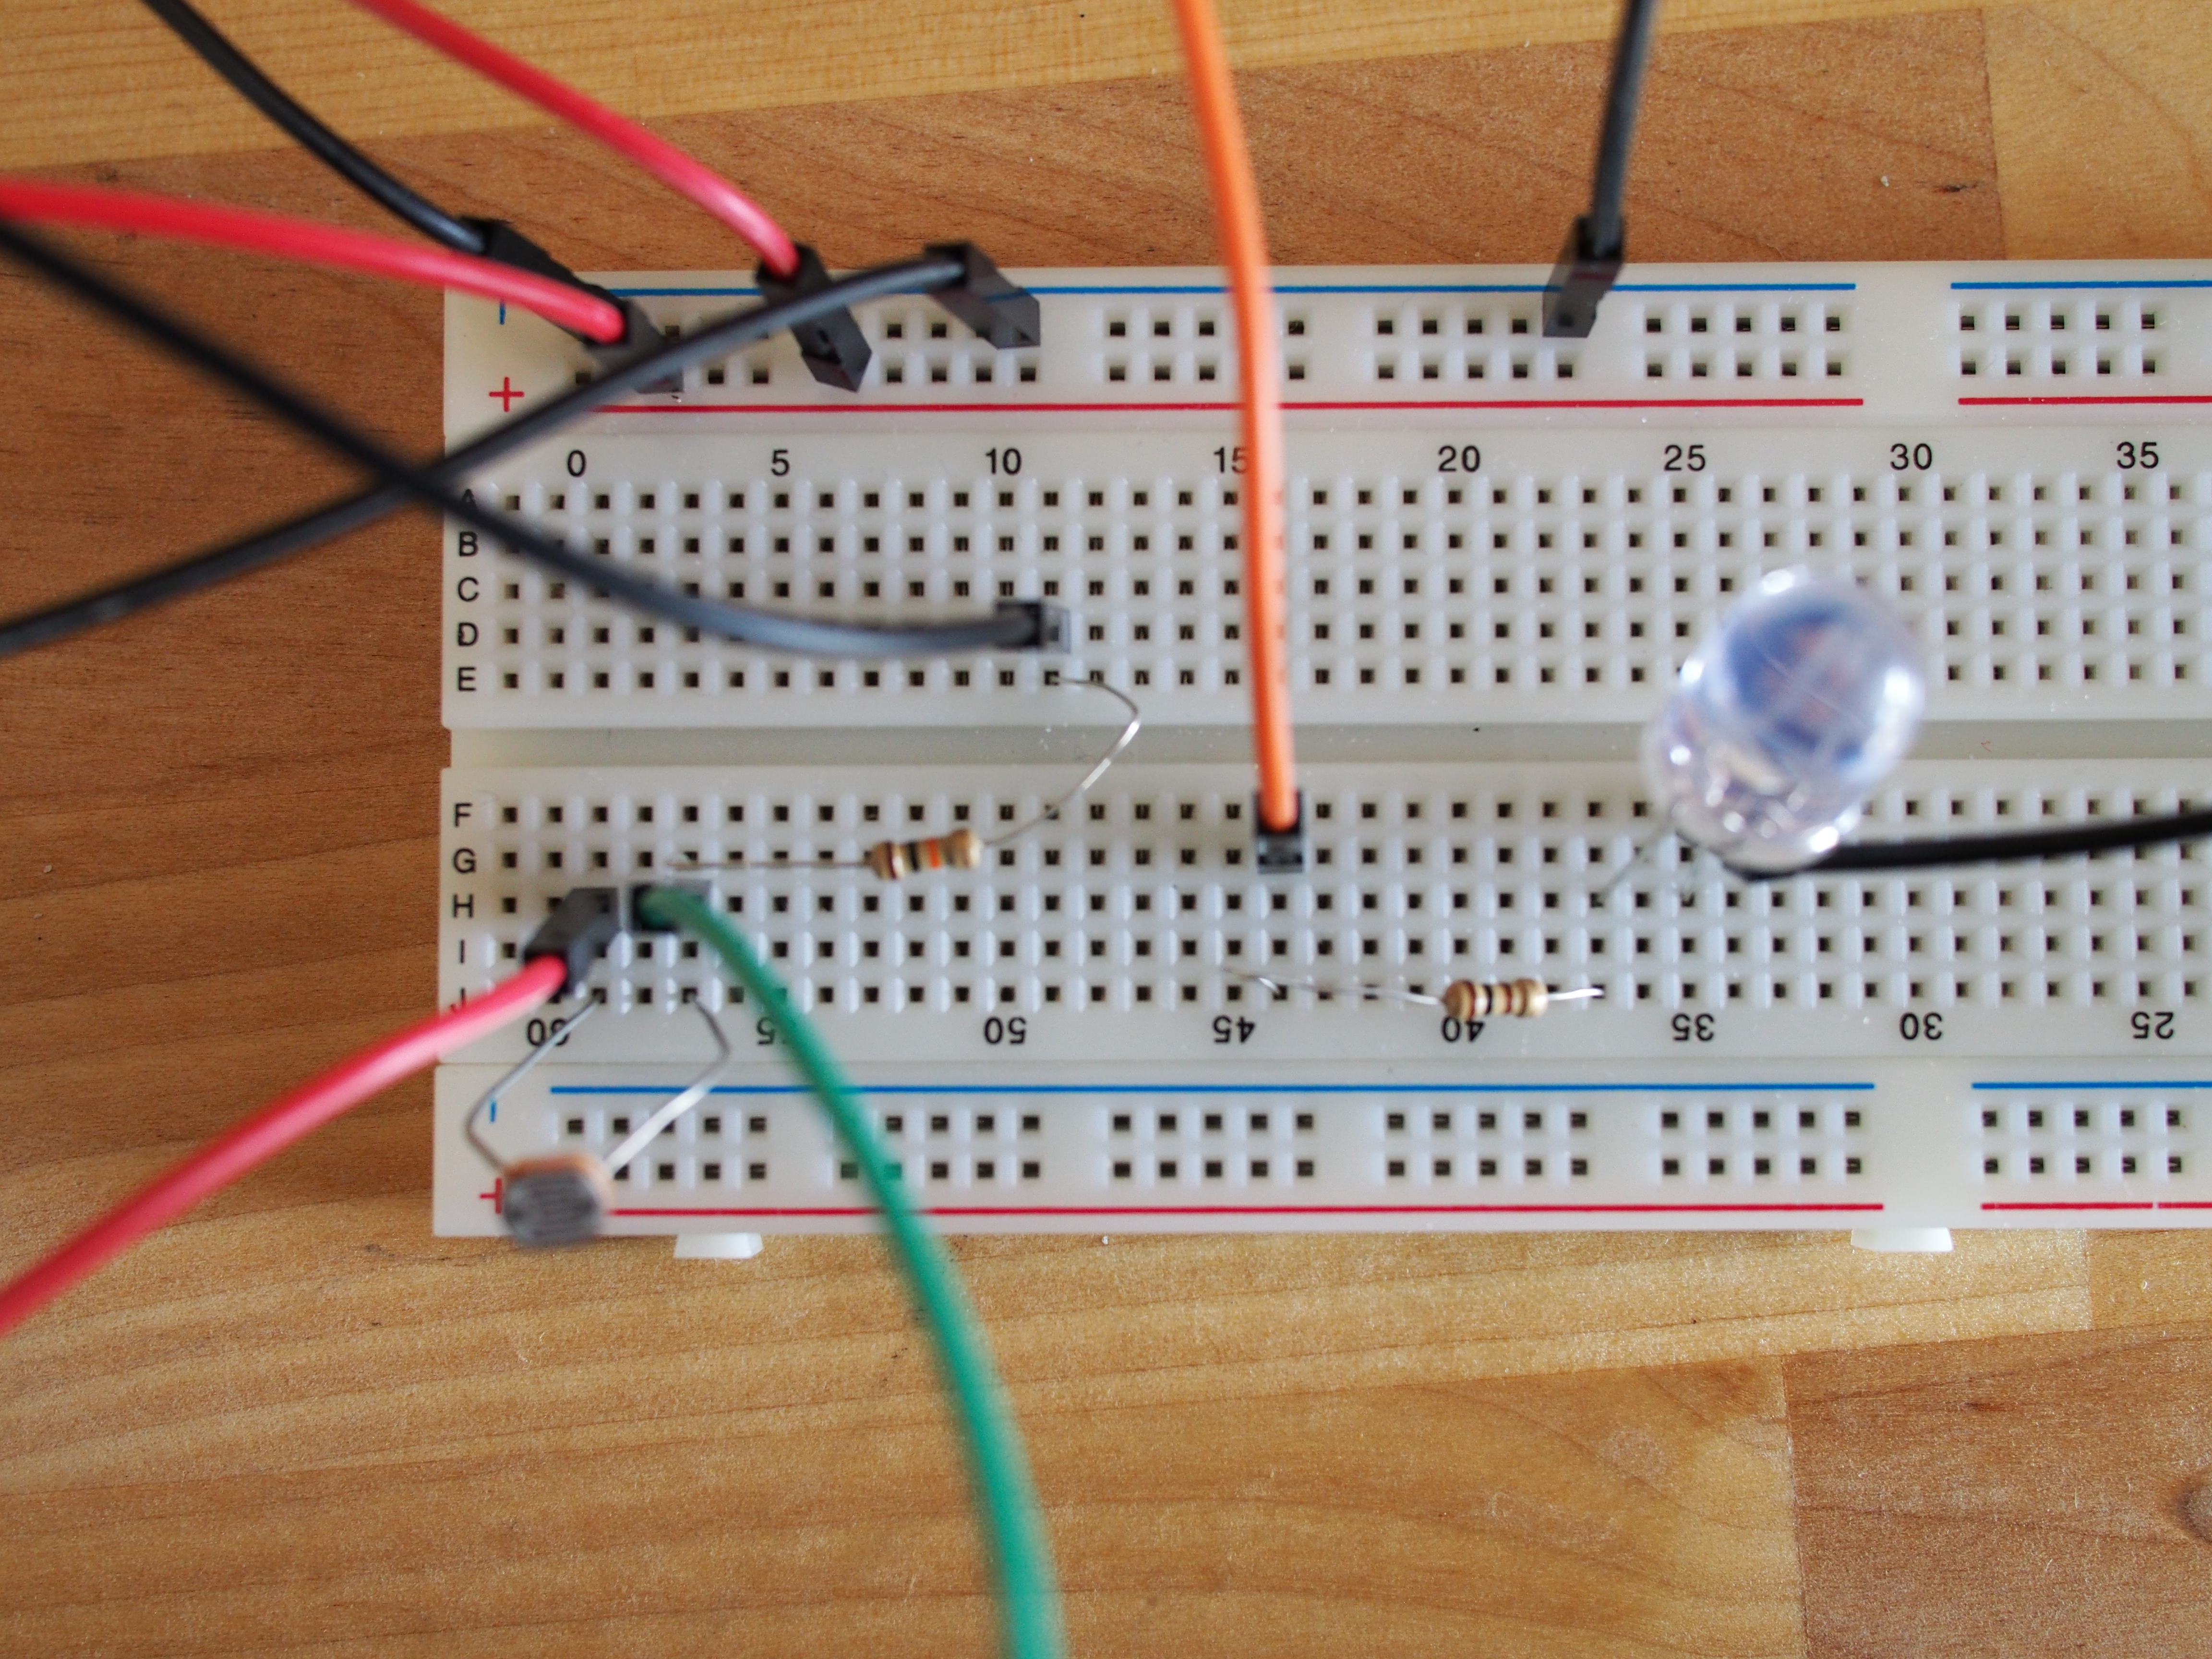
What are we going to build?
S4AFirmware program
Scratch Program

Slide 19
Circuit Diagram
100 Ω
9 5V
A0
Arduino
W
10K Ω
GND

Slide 20
Did you download and install the Scratch4Arduino?If not …
Go http://s4a.cat/
Download the software appropriate for your computer
Windows
Mac
Linux
Install Scratch4Arduino

Slide 21
Installing S4A on Mac
S4A installation on Mac needs work around:
Security permissions need to be changed to "Anywhere" in order to open the app.
https://groups.google.com/forum/#!topic/s4a-community/5e_ge7XKehw

Slide 22
Load the S4A Firmware sketch to the Arduino
Locate the file S4AFirmware15.ino
Run Arduino software
Open the sketch S4AFirmware15.ino
Connect Arduino and upload the sketch to Arduino board using Arduino software
Make sure it loaded successfully!
Exit the Arduino software once done!

Slide 23
Load the S4A Firmware sketch to the Arduino

Slide 24
Connect to wireless network “devoxx4kids”

Slide 25
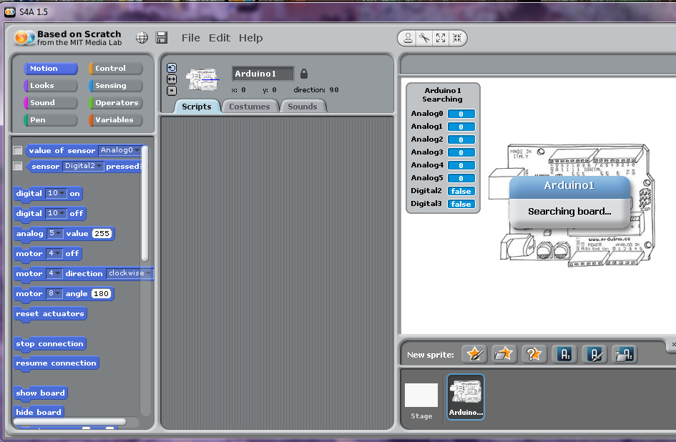
Run Scratch 4 Arduino

Slide 26
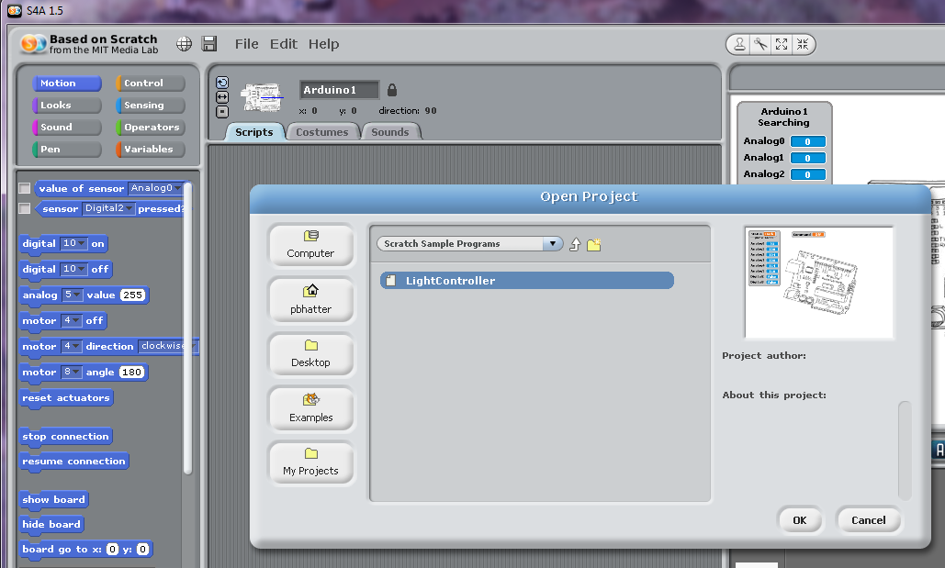
Open the project LightController
Navigate to Menu : File > Open
Find, select and open the file LightController

Slide 28
“LightController” project
Arduino is connected to the computer.
The message “Searching for board” should go away
Did you see the message “Remote Sensor Connections Enabled”?
Are the variables showing running numbers?

Slide 29
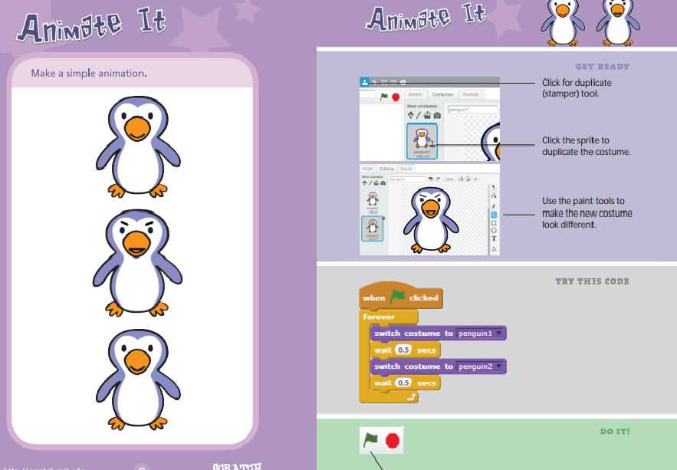

Have you used Scratch?

Slide 30
What is Scratch?
Scratch is a programming environment where you can create your own interactive stories, games, and animations
You can use it on internet or you can download and run it on your computer
We will download and run on the computer
Info and downloads at: http://scratch.mit.edu/

Slide 31
What is Scratch for Arduino?
S4A is a Scratch modification that allows for simple programming of the Arduino.
It provides new blocks for managing sensors and actuators connected to Arduino.

Slide 32
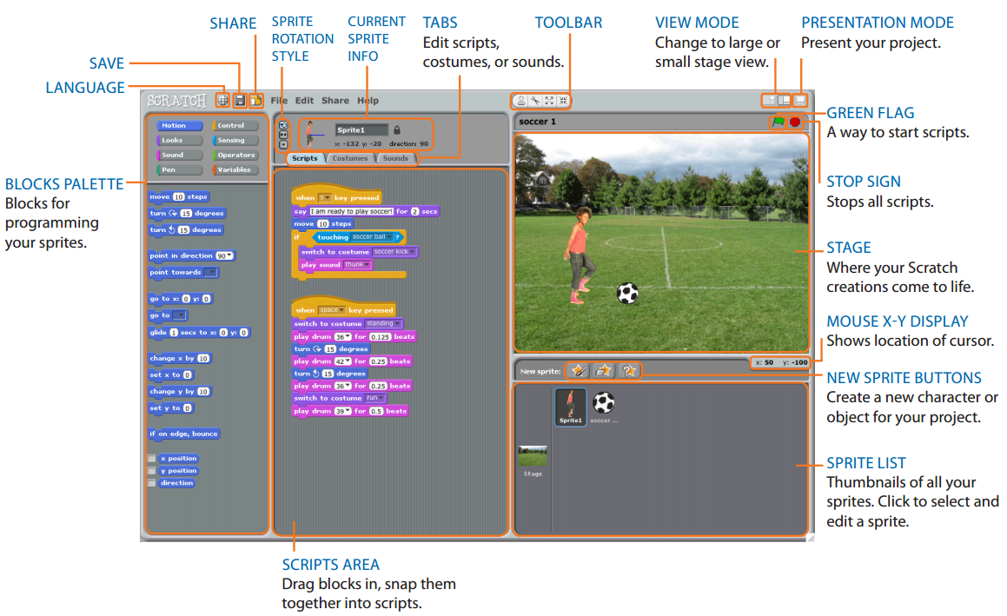

Slide 33
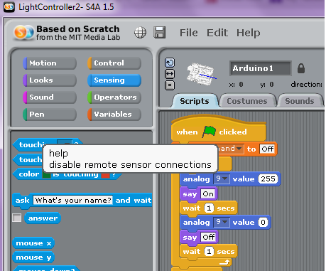
Enable remote sensor connection
> Click on “Sensing” Block Palette
> Right click on one of the blocks, “help” menu will open.
> Click on enable remote sensor connections.

Slide 34
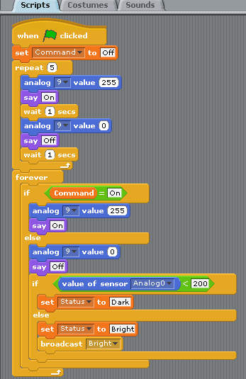
> Click on the green flag
to start the program
> Did the LED Blink 5 times?

Slide 35
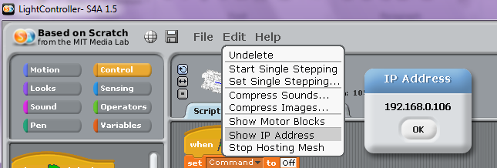
Note the IP address of your computer
> Click on menu “Edit” > “Show IP Address”
> Note down the IP Address displayed

Slide 36
Command to check light around sensor
http://192.168.0.106:42001/?send_vars

Slide 37
Commands to turn on or off the LED
http://192.168.0.106:42001/vars-update=Command=On
http://192.168.0.106:42001/vars-update=Command=Off

Slide 38

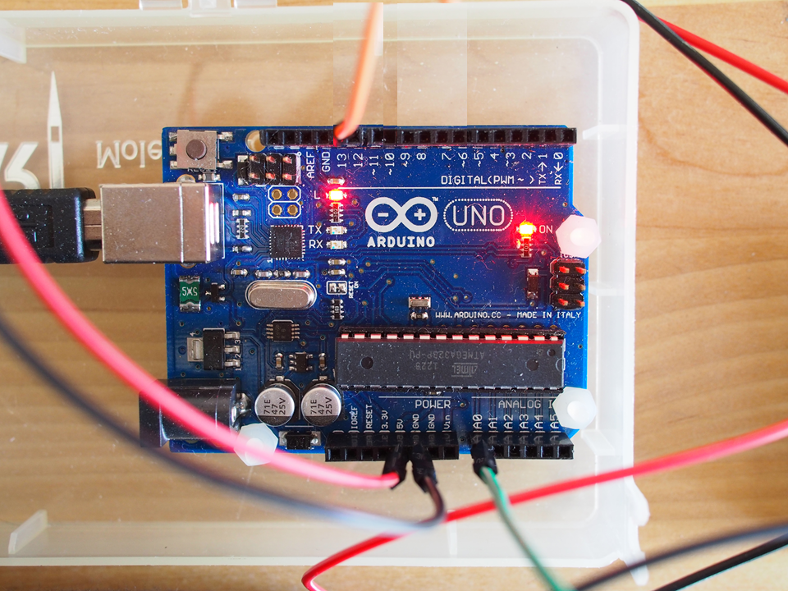

How does it work?
Scratch Program
Network

Slide 39
Let’s meet the Arduino again ….
I/O pins
Reset pin
USB
Port
LEDs
ATMega328 MC
7-12V
DC input
Power pins
Analog input pins

Slide 40
Books
Exploring Arduino by Jeremy Blum
Programming Arduino Getting Started with Sketches
Programming Arduino Next Steps by Simon Monk
Arduino Cookbook by Michael Margolis

Slide 41
Useful websites
Arduino reference www.arduino.cc/en/Reference/HomePage
Arduino forum www.arduino.cc/forum
Ideas for projects http://www.instructables.com/
Ideas for projects http://makezine.com/
http://www.allaboutcircuits.com/
http://www.wikipedia.org/

